Slide 1
ALL AUGMENTATIONS WHICH WORKED ON

Slide 2
1 Pixel-Shift & Flip
Here, the idea is to combine two augmentation techniques.
Flip
Shift by 1 pixel on both horizontal and vertical directions.
Reason:
In this research paper, it is clearly mentioned how CNNs are effected by even small number of pixel shifts. The mean reason for this fluctuation is Max Pooling layers. As the Max Pooling layer’s window slides over odd number of pixels, it is completely ignoring the information of even number of pixels in both horizontal and vertical directions. And this can be avoided using blur pool where we will apply blur before passing anything into a max pooling layer.
In our solution, we will shift the image by 1 pixel horizontally and vertically so that now the even pixels are in the place of odd pixels and the Max Pooling layer’s window can consider them. So, rather than doing this individually, we have clubbed this with flipping. Due to this, we are ensuring that the model is getting all the pixel level information. The effect of this augmentation can be seen in the top layers.

Slide 3

POOLING LAYERS

Slide 4
Pooling with 1 pixel shift
0 | 0 | 0 | 0
0 | 7 | 3 | 5
0 | 8 | 7 | 1
0 | 4 | 9 | 3
Max Pooling
7 | 5
6 | 9

Slide 5
Pixel information
8 | 6
9 | 9
7 | 5
6 | 9
Pooling without 1 pixel shift
Pooling with 1 pixel shift

Slide 6
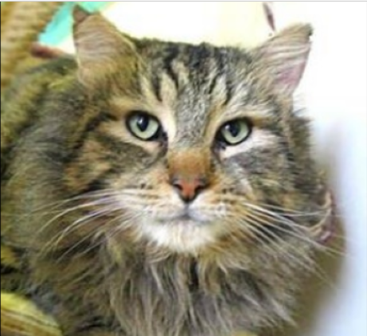
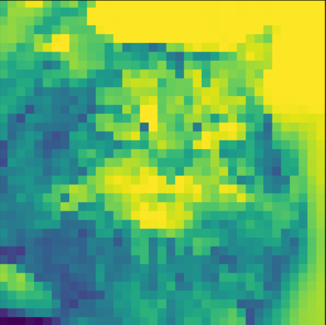
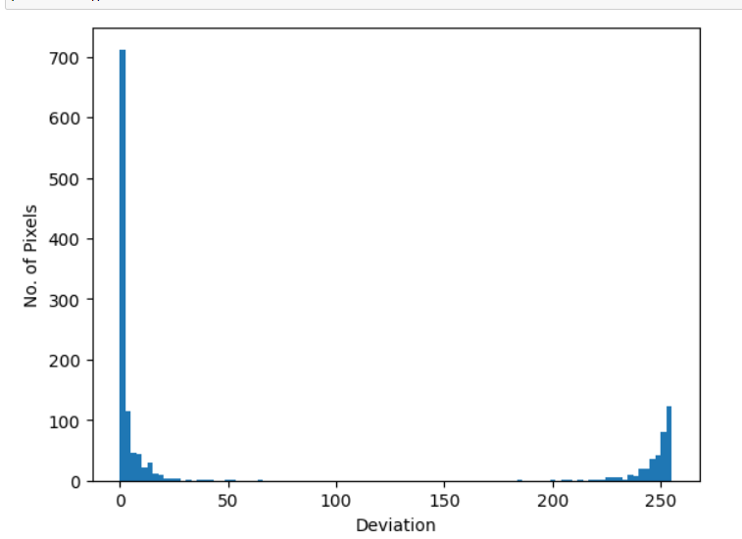
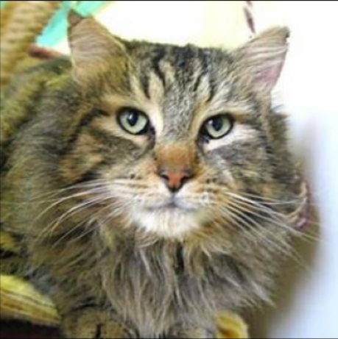
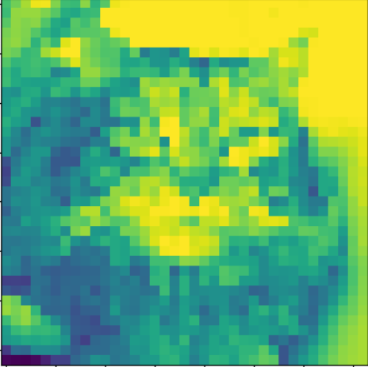
Original Image
Third Max Pooling
Pixel level deviation between both pooling outputs.
Total No. of Pixels: 1369 (37 X 37)
No. of Pixels with deviation: 760
Percentage: 55.51% of the pixels deviated to some extend.
Shifted by 1-pixel h/v
Third Max Pooling

Slide 7
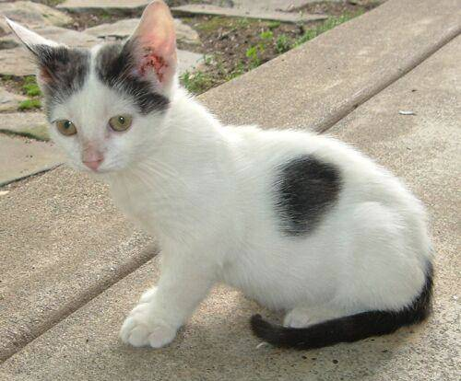
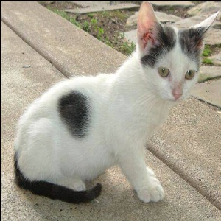
Flipping with 1 pixel shift
Flip + 1 Pixel shift
Original

Slide 8
Advantages and Disadvantages
Advantages | Disadvantages
By shifting the images by 1-pixel, we are easily ensuring that the model will get all pixel values to learn. And with the inclusion of flipping, we are efficiently getting the benefits of both. | If there is not much change in the pixel information of even and odd, we may not see any impact on the performance.
As these are just based on image modifications, the resource requirement is very low. | If the texture detection is not important, then this augmentation is not the appropriate one.
It is a very simple augmentation technique. We just have to perform shift and flip operations. So, complexity in coding is low.
It improves the robustness of the model at pixel level modifications.

Slide 9
ACTIVATION SUPPRESSION
Here, the idea is to block the features which the model already learned using a neutral color like gray and also, we can apply additional stylize effect like oil paint, cartoonization, etc.
Algorithm:
Step 1: Train the base model.
Step 2: Pass each image from the training dataset and get the activation map.
Step 3: Find the top n activated regions (optimal value of n = 3-5).
Step 4: Fill those regions with a circle of a neural color.
Step 5: Apply a Stylize effect and that model is not remembering any pixel information.

Slide 10
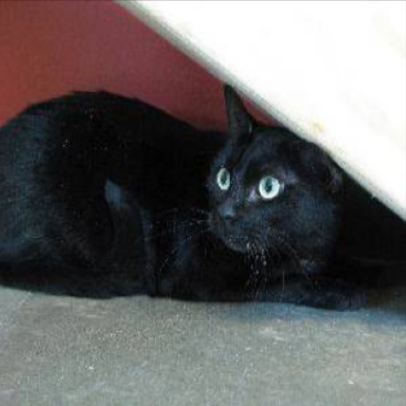

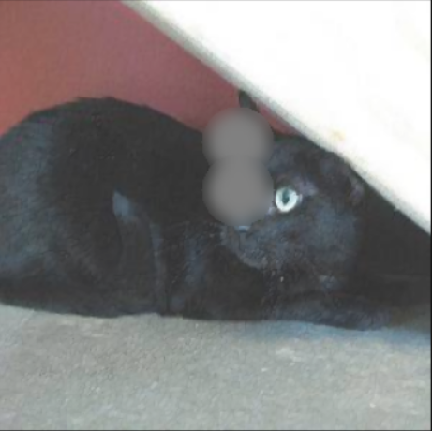
Original Image
Feature Map
Suppressed two top activation regions

Slide 11
Advantages and Disadvantages
Advantages | Disadvantages
Dynamic Augmentation technique. Means, the changes are made to the original data based on the current model’s understanding. | If the model already learned the features then this technique produces no effect.
No wastage of resources as we are teaching the model which it did not know. | If the subject is very small i.e less than the size of the suppression circle, it produces images with no subject. This can reduce the model’s performance.
Improves the feature representation of the image. This reduces the black box effect of the neural network. | We need to have a base model in order to apply this technique.
It also creates the effect of occlusion. Due to that, it improves the inference mechanism of the model. | If the model is deeper, the time and resource consumption for the data generation will be high.

Slide 12
ADAPTIVE COLOR SCHEME
Here, the idea is to find the color shades of an image such that, they have more impact on the model’s learning. In Adaptive color scheme, we will analyze histogram of every image and find the top shades which are not at all present in the image and apply that shade on the image.
This is an efficient technique to improve the model’s invariance to colors. Rather than providing every shade, we are providing the shades which are not at all learned by the model.

Slide 13
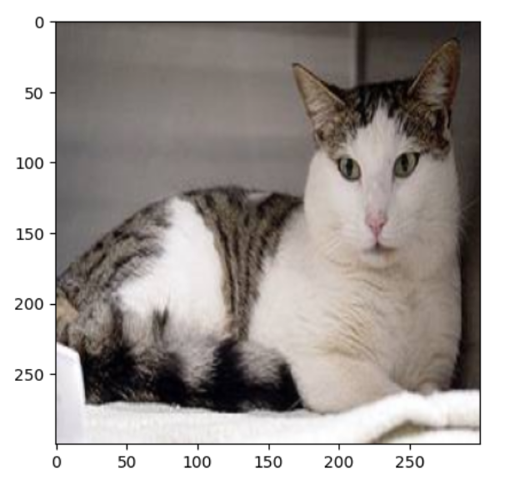
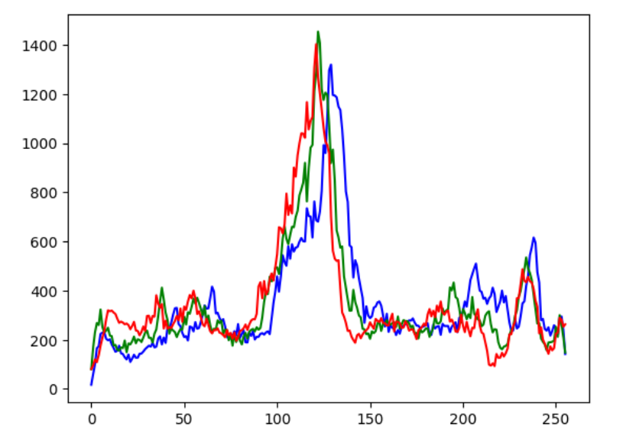
Adaptive Color scheme

Slide 14
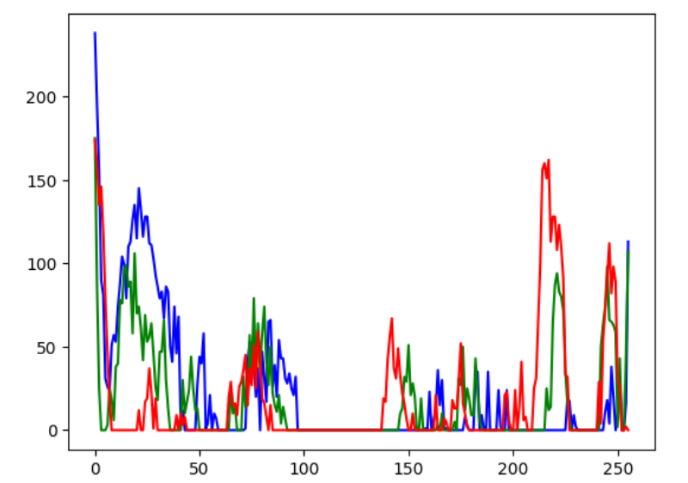
Adaptive Color scheme

Slide 15
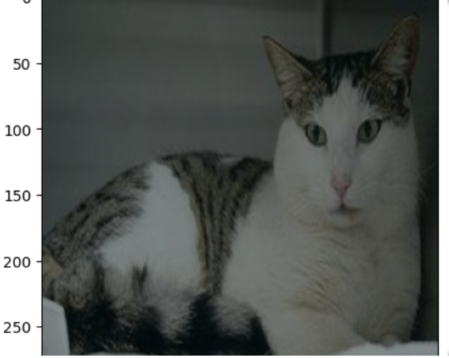
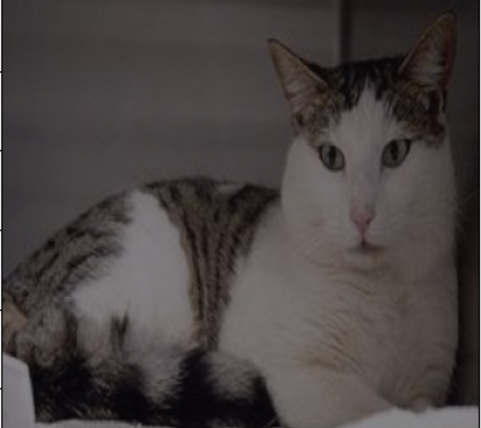
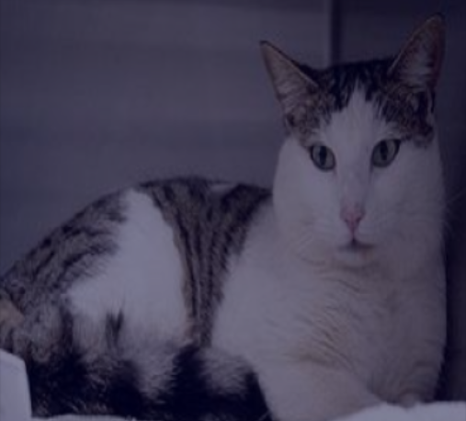
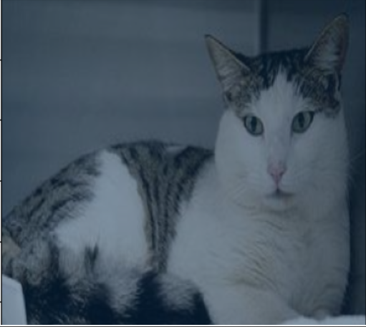
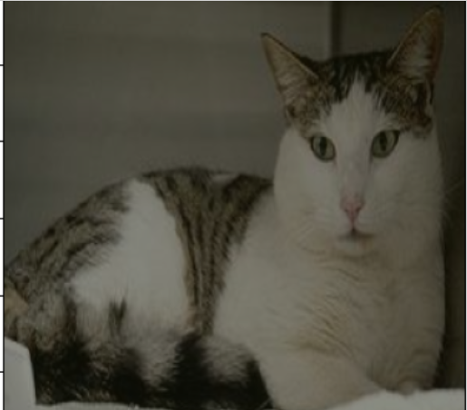
Adaptive Color scheme

Slide 16
Advantages and Disadvantages
Advantages | Disadvantages
Dynamic Augmentation technique. So, the new shades which are produced are according to the input image. | It will make the model color invariant to some extend but it is not truly color invariant.
The generate shades will have high impact on the model as the model did not see this shade. So, it is an efficient augmentation technique. | There is no direct method to decide on the number of shade we will produce. Sometimes, we may produce shades which the model already knowns. In such cases, it will not have any impact.
Rather than providing many shades in order to make the model color invariant, we will provide top shades which can impact more on the model towards making it color invariant.

Slide 17
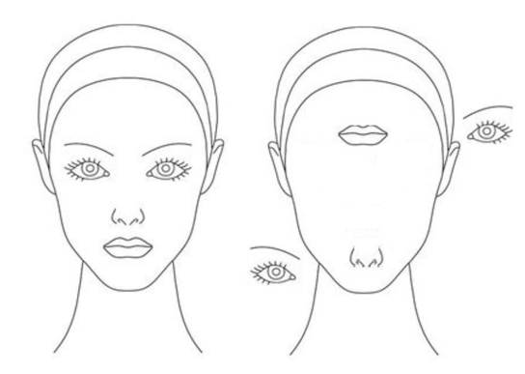
TILES SHUFFLING
Here, the idea is to divide the image into 9 tiles and swap them or jumble them randomly. The main goal of this technique is to convert a binary problem into categorical and also to improve the model’s ability to consider relative positions of the features. It is important to consider the relative spatial information because in the example, a CNN model will give same prediction irrespective of the positions of the features. It is one of the biggest disadvantage of CNN. So, using tile shuffling augmentation, we can address this issue to some extend.

Slide 18
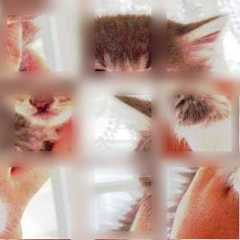
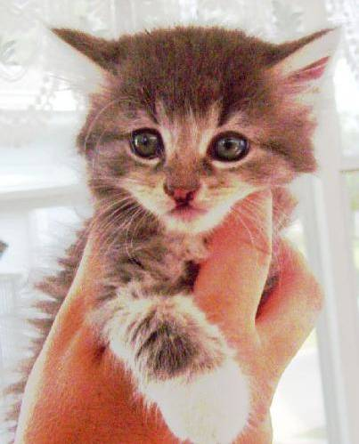
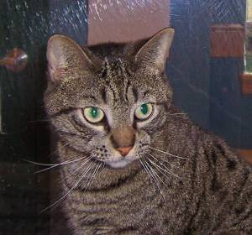
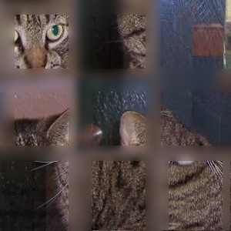
Tiles shuffling
Shuffling
Shuffling

Slide 19
Advantages and Disadvantages
Advantages | Disadvantages
Using this technique, we can convert a Binary classification problem into Categorical classification problem. As we know the issues of Binary classification problem | It is somewhat harder to test the image of this technique.
It improves the model’s understanding of the relative spatial information of different features. | If there is no priority for the spatial information, then this technique is not the appropriate one.
There are total 9! Combinations possible for each image. So, virtually, we can generate as much as data we want using this technique. This is an advantage because, we need data to be balanced among the classes.

Slide 20
Low-level Residual
This technique is inspired from Resnet. As the name suggests, this technique is designed to improve the edge detection at the top layers. In this technique, we will cover the regions where edges are detected with a neutral color and show the non-detected part. Due to this, the model will look for new different types of edges. We will cover the regions where the convolutions of a kernel are producing high values. So, we will be manipulating at pixel level. Due to this, the kernels are directly regularized and forced to learn to detect new types of edges.
In this technique, after generating the low-level residuals, we will freeze all the layers except the top layers. Due to this, the changes in the top layers can be seen directly at the output. This solve vanishing gradient problem. And also, as we have less training parameters, the resource and time consumption is less.
As we are introducing artifacts into the image, from one perceptive, we are introducing noise into the image. So, this technique will also provide the impact of noise injection augmentation.

Slide 21
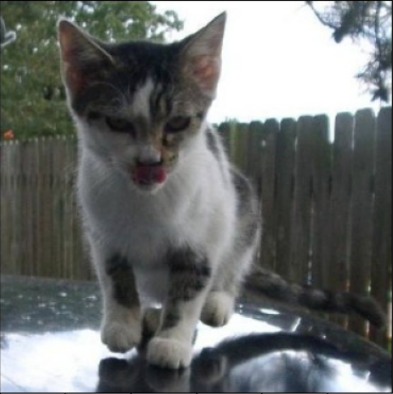
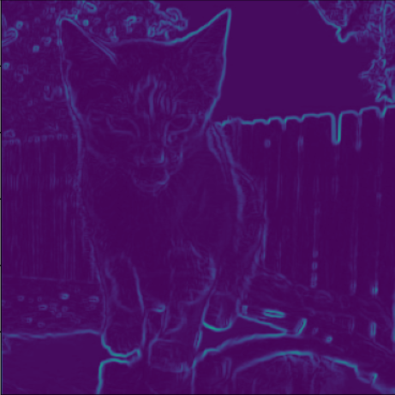
Original Image
Edges Detected at the first layer

Slide 22
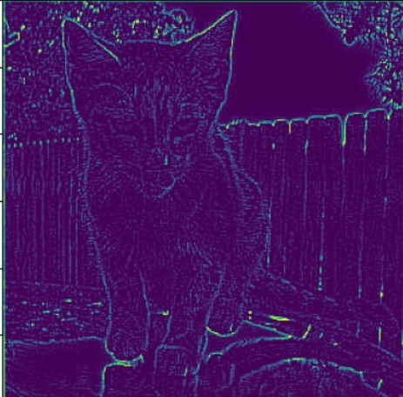
Original Image
Edges Detected using Laplacian edge detector

Slide 23
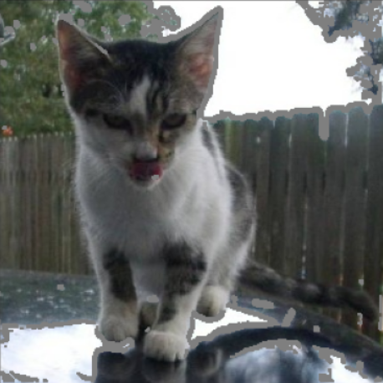
Original Image
Applying the Low-level residual augmentation

Slide 24
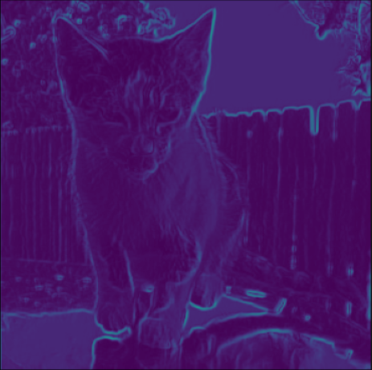
Original Image
Improved Edge Detection

Slide 25
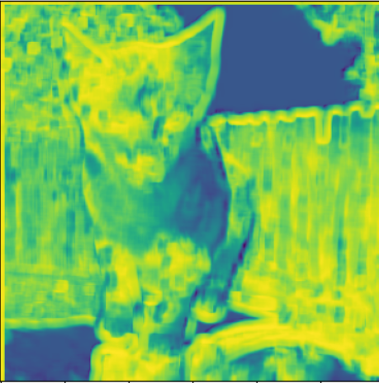
Deviation Map
Edges without LLR augmentation
Edges with LLR augmentation
Structure Similarity Score: 78.94%

Slide 26
Advantages and Disadvantages
Advantages | Disadvantages
Dynamic Augmentation technique. Here, we are injecting the artifacts based on the model’s current understanding of edges. | If the model already learned the detection of all types of edges, this augmentation will not have any impact.
As the artifacts are at the pixel level, the kernels are directly regularized. | Overtraining with this data can have negative impact on the performance.
As only top layers are trained, we have less training parameters. So, we can have the resources and also, the changes in the top layers have direct impact on the output. Due to this, we don’t face any vanishing gradient problem. | We need to have a base model in order to apply this technique.
We currently, implemented this for low-level features but we can also extend this to high level features.
As we are producing artifacts at the pixel level, from one perceptive we are injecting noise in the image. So, this augmentation can improve the model’s robustness to noise.

Slide 27
Texture Information Encoding
This technique is developed as an alternative to 1-pixel shift + flip augmentation technique. In this approach, we will address the issue directly at the root level. In this technique, we will try to incorporate the information from the evenly spaced pixels onto the oddly spaced pixels. By doing this, we can ensure that, the information is still preserved even after performing max pooling. The impact of this technique can only be seen if the image have some texture information. In other cases, it may not provide much impact.

Slide 28
Oddly placed pixels. Pooling happens here
Evenly placed pixels. Pooling does not happen here
Exchange of Information

Slide 29
Oddly placed pixels. Pooling happens here
Evenly placed pixels. Pooling does not happen here
Exchange of Information

Slide 30
Oddly placed pixels. Pooling happens here
Evenly placed pixels. Pooling does not happen here
Exchange of Information

Slide 31
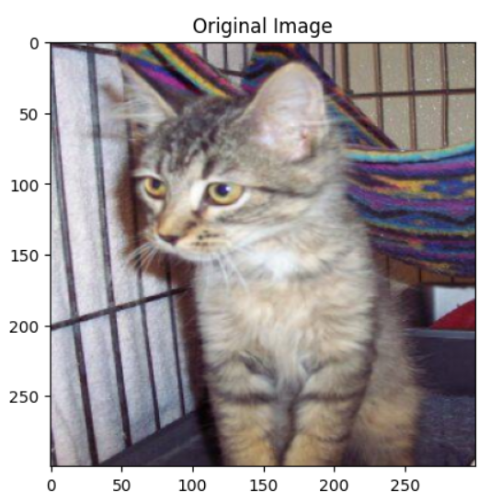
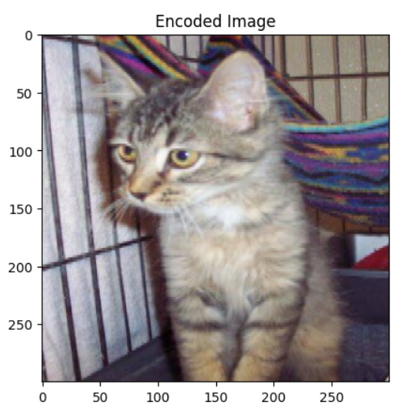
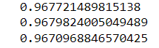
Red:
Green
Blue:
We can see that in all channels we can see that there 4% that is not same. Here, that 4% is nothing but the texture information that is incorporated.
The images will look identical as that is the goal, we don’t want to change the image completely rather, we want to include the required information without much changes in the original image.
Structural Similarity of each channel

Slide 32
Advantages and Disadvantages
Advantages | Disadvantages
Using this technique, we can underlyingly incorporate the required texture information without producing much changes. | As images are going to be identical, in terms of structural detection, it may not improve the model’s performance.
This is an information preserving technique, so during the pooling operation, even though the window does not slide over evenly spaced pixels, we can still get the impact as if it is sliding over evenly spaced pixels. | If texture information not the main goal then this technique may not be appropriate one.
For applications which deal with texture information, this technique can give much impact.

Slide 33
CONTRASTIVE LEARNING
Contrastive Learning is a technique of training a model. In this approach, we will provide data which are contrasting to each other so that the model learns the extremities and tune the threshold for wide range. Due to this, the model stands robust to different variations in the image.
Note: In this method of training, the contrastive data need to be kept in the same folder.

Slide 34
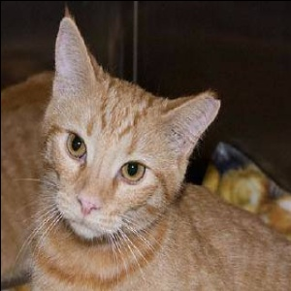
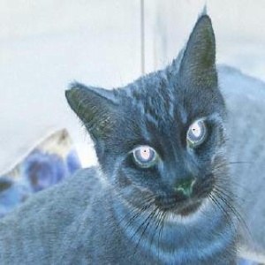
Original
Negative
It improves the edge detection of the model as the only thing constant among the two images are edges. And also, it improves the robustness to the colors.

Slide 35
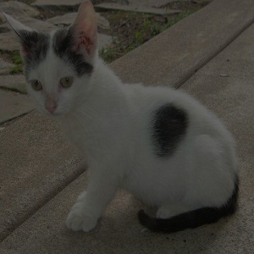
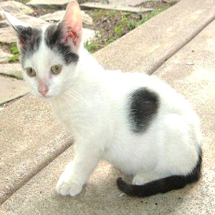
Darker
Brighter
By providing the extremities in the range of pixel values, the thresholds of the model are tunes to detect features at wider range of lighting conditions. And also, it is efficient as we don’t need to provide more different lighting conditions.

Slide 36
Advantages and Disadvantages
Advantages | Disadvantages
It is an efficient approach of learning, as we are trying to tune to model’s threshold to accept wide range. | If the information to be learned is not range specific, this augmentation may not be appropriate.
In this approach, we need not provide all types of data. For example, all types of lighting conditions. We just need to provide the extremities of different lighting conditions. | The approach get best impact if trained isolated. But, if we overtrained it, it may forget or loss the information of original data.
As we need to provide only the extremes, it is an efficient data generation.
It also creates the effect of occlusion. Due to that, it improves the inference mechanism of the model.

Slide 37
TRANSFERABLE MODELS
Here, the idea is to transfer the knowledge from one part of the model to another if it is transferable. So, rather than training the model extensively, we only need to train the model at the require amount and the rest of it can be simply transferred.
In other words, it is about inter model communication mechanism. In our brain, we have this internal communication where information learned from one area can be used in another area. In the same way, if we can develop, models with this capabilities, we can make robust models with less training data and smaller in size.

Slide 38
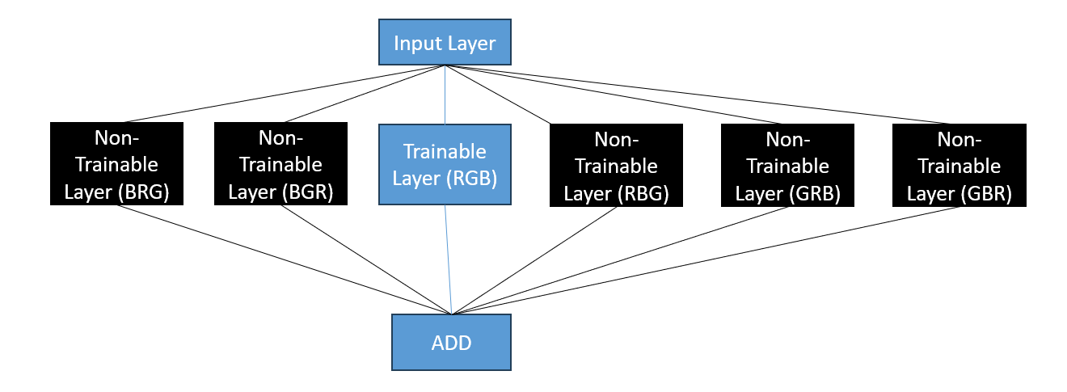
TRANSFERABLE MODELS
Only the center layer is trained and rest of the layers are initialized with zero weights and frozen from training.

Slide 39
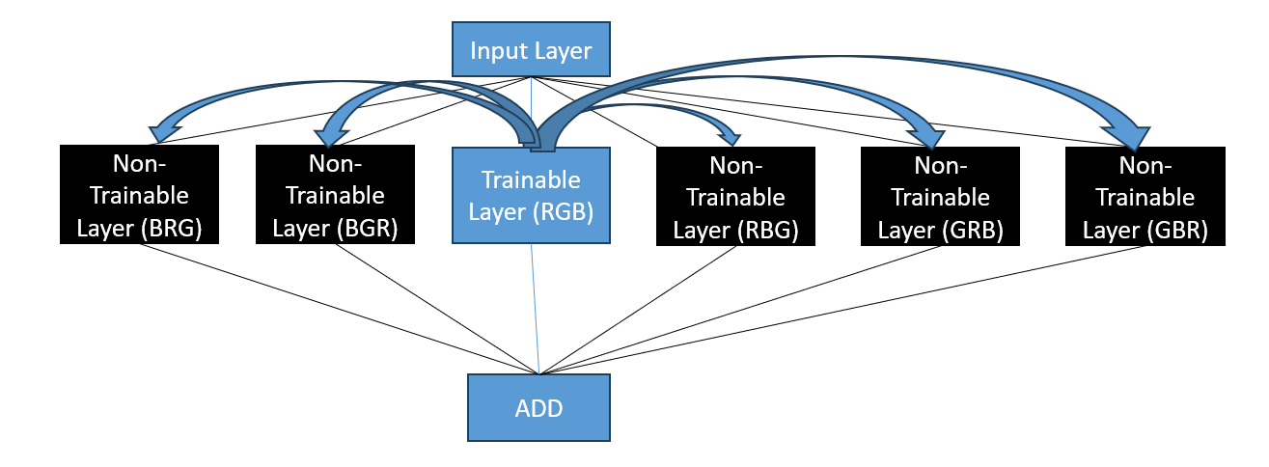
TRANSFERABLE MODELS
Color information is transferred from one layer to another

Slide 40
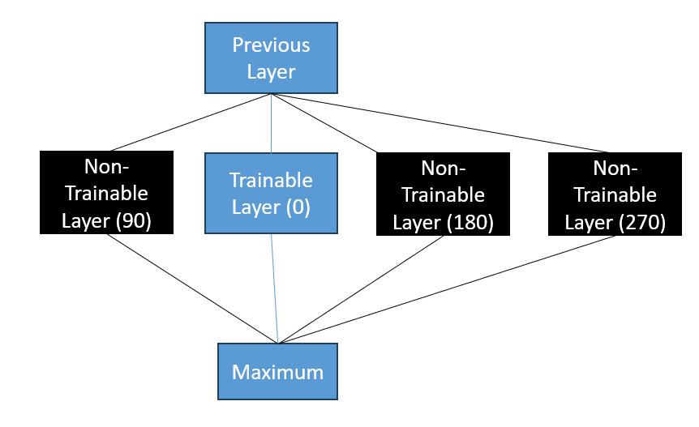
TRANSFERABLE MODELS
Only the center layer is trained and rest of the layers are initialized with zero weights and frozen from training.

Slide 41
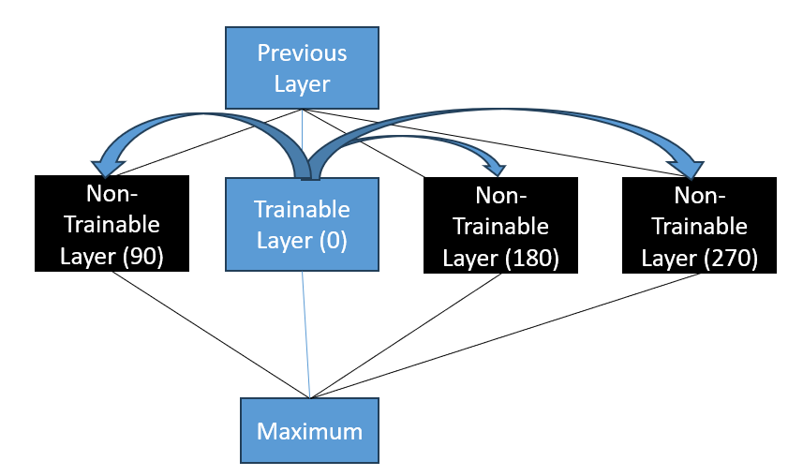
TRANSFERABLE MODELS
Rotation information is transferred from one layer to another

Slide 42
Advantages and Disadvantages
Advantages | Disadvantages
This design is inspired from the working of brain. It is an efficient way of learning. | We can get this advantage only if the knowledge is transferable.
This approach can give more impact with less data and training time as we just need to transfer the rest of the knowledge. | The design can be complicated.
As, we have less training parameters, we can reduce the size of the model. | As we making the model wider, the prediction time can increase.
These models have capability to change their learning in the real-time. Due to this, these types of models can be used mobile phones, etc. | In this approach, as we are manipulating the kernel weights, it will damage the inference mechanism of the model. To solve this, we need to retune the model by unfreezing all the layers.

